Slide 1
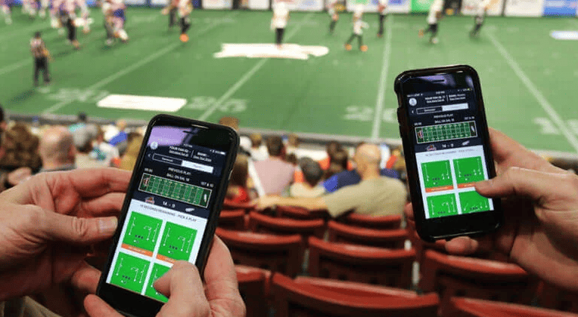
Predicting Fantasy Sports
Patrick Sullivan

Slide 2
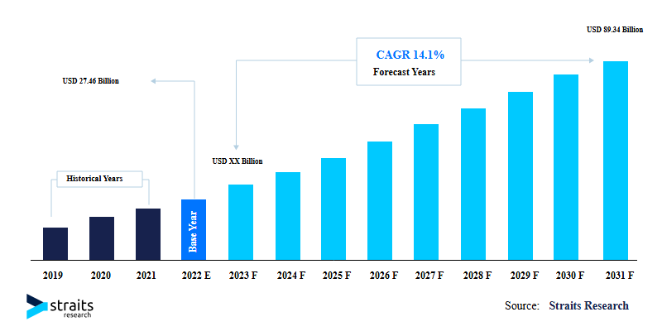
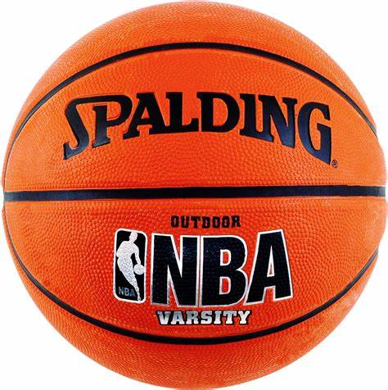
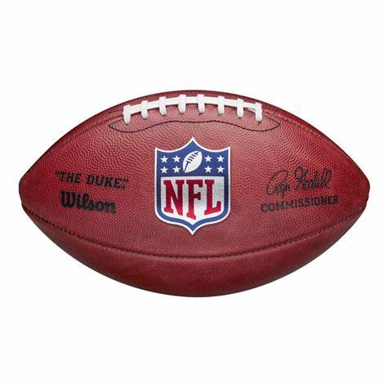
Future of Fantasy Sports
27.46 Billion in 2022 to 89.34 Billion in 2031

Slide 3
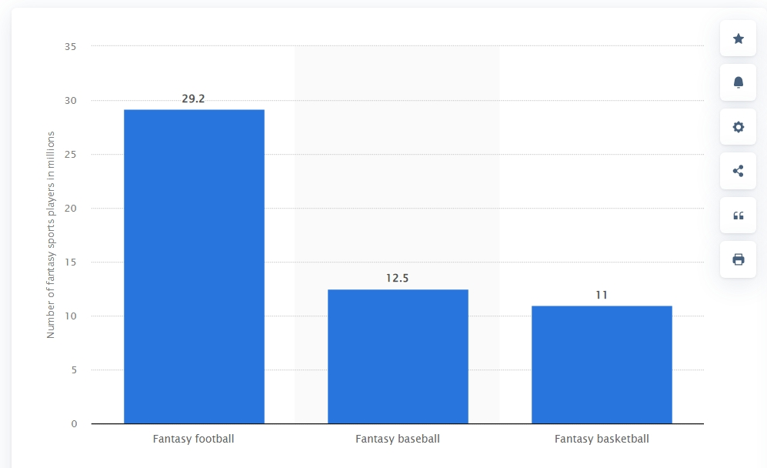


Fantasy Sports Industry
Fantasy Sports is Focused on Two Kinds of Fantasy
Daily
Draftkings, Caesars Entertainment, Prize Picks
Seasonal
ESPN, Super7, Yahoo
My Focus: Seasonal Sports, Specifically in Football
Most Played Fantasy Sports, US 2022

Slide 4
Target Audience
FOOTBALL TEAMS
COMPANIES
PLAYERS
ESPN + Yahoo Developers want to give players accurate predictions so they trust the Product
Players want to go to a product where they are given valuable insights on how well a player will do
If you are able to predict how well a player can do, that means teams will want to go on that analysis and get the winning players

Slide 5
My Project
Predicting if a Running Back will Have a Good Season based on the following features:
Used NFL Team + Game Data from 2012-2022. I included:
Their Stats in Past Seasons
Their Basic information
Their Teammates Stats
Their Scheduled Opponents Stats
Their Teams Stats

Slide 6
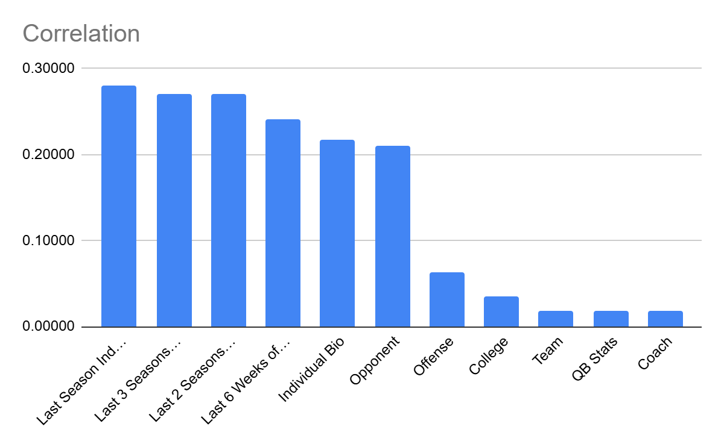
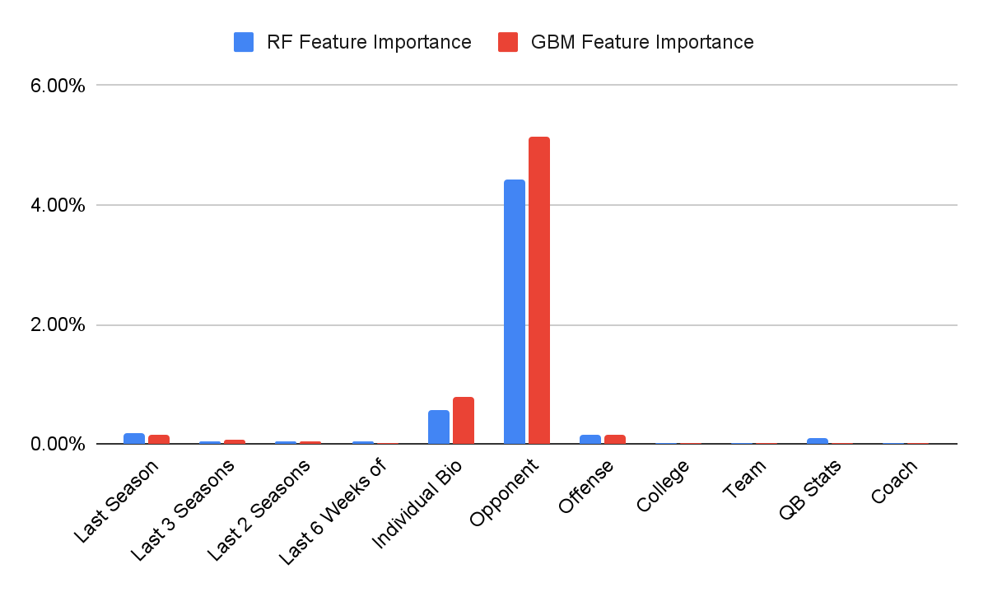
Model Chosen + Features Categories
Goal: Predicting how many Fantasy Points they will have for the season
Because Goal is moving, Linear Regression was my best option

Slide 7
Features Chosen
Name | Test_Size | Random_State | Num Features | MSE | R2 | MAE
Top 3 Per Category | 0.2 | 42 | 22 | 1438.058727 | 0.6930170924 | 27.20571065
Top 1-2 Per Category | 0.2 | 42 | 11 | 1675.560118 | 0.6607030006 | 28.48321915
Top 1-2 Per Category | 0.2 | 42 | 11 | 1710.862908 | 0.6535542683 | 28.4672937
Remove 1 from Top 3 Per Category | 0.2 | 42 | 21 | 1473.973545 | 0.7015238094 | 26.43111537
Notes:
Total Pro bowls defenders faced in past 3 years',
'last_season_total_yards_mean',
'last_season_fantasy_points_mean',
'Total pro bowls offensive teammates past 3 years',
'last_season_rushing_yards_mean',
'last_2_seasons_fantasy_points_mean',
'last_3_seasons_fantasy_points_ppr_mean',
'last_2_seasons_total_yards_over_100_mean',
'last_3_seasons_total_yards_over_100_mean',
'Total Pro bowls defensive linemen faced in past 3 years',
'last_3_seasons_fantasy_points_mean',
'last_weeks_of_last_season_fantasy_points_ppr_sum',
'last_3_seasons_total_yards_mean',
'last_2_seasons_total_yards_mean',
'draft_number',
'last_weeks_of_last_season_total_yards_mean',
'Total Pro bowls defenders faced in past year',
'Amount of Pro Bowls in Last 3 Years',
'Total Pro bowls offensive linemen teammates in past 3 years',
'round',
'weight'

Slide 8
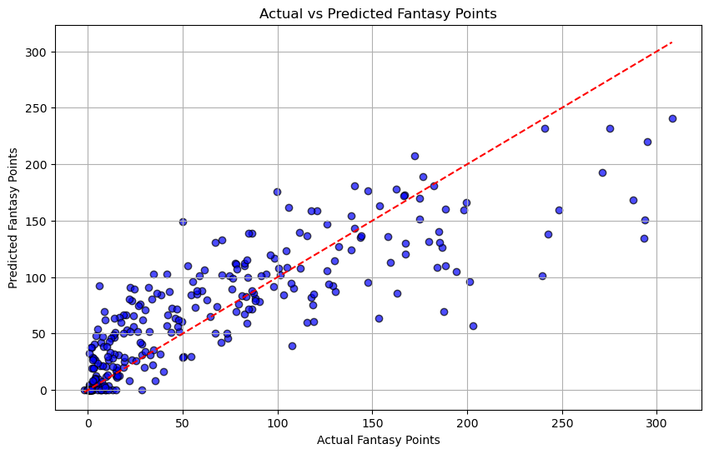
Testing Model
Tested Model against 2023 Data
Number of Running Backs | Average Difference | Average Difference Per Game
136 | 31.06 | 1.83
Notes:
Total Pro bowls defenders faced in past 3 years',
'last_season_total_yards_mean',
'last_season_fantasy_points_mean',
'Total pro bowls offensive teammates past 3 years',
'last_season_rushing_yards_mean',
'last_2_seasons_fantasy_points_mean',
'last_3_seasons_fantasy_points_ppr_mean',
'last_2_seasons_total_yards_over_100_mean',
'last_3_seasons_total_yards_over_100_mean',
'Total Pro bowls defensive linemen faced in past 3 years',
'last_3_seasons_fantasy_points_mean',
'last_weeks_of_last_season_fantasy_points_ppr_sum',
'last_3_seasons_total_yards_mean',
'last_2_seasons_total_yards_mean',
'draft_number',
'last_weeks_of_last_season_total_yards_mean',
'Total Pro bowls defenders faced in past year',
'Amount of Pro Bowls in Last 3 Years',
'Total Pro bowls offensive linemen teammates in past 3 years',
'round',
'weight'

Slide 9
How Users Should Use Model
Built More for Seasoned Vets rather than New Players
Cannot Account for Injuries
Built only for Running Backs
Notes:
Total Pro bowls defenders faced in past 3 years',
'last_season_total_yards_mean',
'last_season_fantasy_points_mean',
'Total pro bowls offensive teammates past 3 years',
'last_season_rushing_yards_mean',
'last_2_seasons_fantasy_points_mean',
'last_3_seasons_fantasy_points_ppr_mean',
'last_2_seasons_total_yards_over_100_mean',
'last_3_seasons_total_yards_over_100_mean',
'Total Pro bowls defensive linemen faced in past 3 years',
'last_3_seasons_fantasy_points_mean',
'last_weeks_of_last_season_fantasy_points_ppr_sum',
'last_3_seasons_total_yards_mean',
'last_2_seasons_total_yards_mean',
'draft_number',
'last_weeks_of_last_season_total_yards_mean',
'Total Pro bowls defenders faced in past year',
'Amount of Pro Bowls in Last 3 Years',
'Total Pro bowls offensive linemen teammates in past 3 years',
'round',
'weight'

Slide 10
How to Improve
For Rookies, see if combine data can be used or college numbers
See if it works weekly due to Fantasy players also needed Weekly
How can high draft picks in other positions impact players
Notes:
Total Pro bowls defenders faced in past 3 years',
'last_season_total_yards_mean',
'last_season_fantasy_points_mean',
'Total pro bowls offensive teammates past 3 years',
'last_season_rushing_yards_mean',
'last_2_seasons_fantasy_points_mean',
'last_3_seasons_fantasy_points_ppr_mean',
'last_2_seasons_total_yards_over_100_mean',
'last_3_seasons_total_yards_over_100_mean',
'Total Pro bowls defensive linemen faced in past 3 years',
'last_3_seasons_fantasy_points_mean',
'last_weeks_of_last_season_fantasy_points_ppr_sum',
'last_3_seasons_total_yards_mean',
'last_2_seasons_total_yards_mean',
'draft_number',
'last_weeks_of_last_season_total_yards_mean',
'Total Pro bowls defenders faced in past year',
'Amount of Pro Bowls in Last 3 Years',
'Total Pro bowls offensive linemen teammates in past 3 years',
'round',
'weight'

